Slide 1

Cyclistic's Growth Strategy:
Converting Casual Riders into Profitable Annual Members
Author: Shubham Sharma June 2023

Slide 2
Table of contents
01
02
03
04
05
06
Stakeholders
Background
Business Task
Data Sources
Business Objectives
Recommendations
07
Methodology

Slide 3
Background
Cyclistic, a bike-share program launched in 2016, has experienced substantial growth and currently operates a fleet of 5,824 geo-tracked bicycles across 692 stations in Chicago. The program allows users to unlock bikes from one station and return them to any other station within the network.
Cyclistic focused on building general awareness and targeting broad consumer segments through flexible pricing plans, including single-ride passes, full-day passes, and annual memberships. Casual riders, who purchase single-ride or full-day passes, make up a significant portion of Cyclistic's customer base, while annual memberships are held by dedicated Cyclistic members.

Slide 4
Business Task
Design and implement marketing strategies to convert casual riders into annual members for Cyclistic, with the objective of maximizing profitability and driving future growth. Utilize the flexibility of pricing plans and the existing awareness of the Cyclistic program to target and persuade casual riders to upgrade to annual memberships. Analyze historical bike trip data to identify trends and insights that will inform effective marketing tactics. Leverage digital media platforms to deliver personalized messaging and promotions to increase conversion rates.

Slide 5
Stakeholders
The key stakeholders include :
Lily Moreno (the director of marketing)
Cyclistic marketing analytics team
Cyclistic executive team.

Slide 6
Data Sources
For the Cyclistic bike-share case study, the data source used is the historical trip data provided by Cyclistic. The data includes information about bike trips taken by Cyclistic users over the previous 12 months (April 2020-March 2021).
The historical trip data is publicly available and has been made accessible for analysis purposes. However, it is important to note that the dataset does not include personally identifiable information (PII) of the riders, such as credit card numbers or specific user details.
The dataset consists of multiple files in CSV and Excel formats, representing different time periods or segments of the data. These files need to be downloaded and stored appropriately for further analysis.
It's worth mentioning that the data provided for this case study is fictional and has been created by Motivate International Inc. for educational purposes.

Slide 7
Business Objectives
1. How do annual members and casual riders use Cyclistic bikes differently?
2. Why would casual riders buy Cyclistic Annual Memberships?
3. How can Cyclistic use digital media to influence casual riders to become members?

Slide 8
How do annual members and casual riders use Cyclistic bikes differently?

Slide 9
Executive Summary
41%
Average Trip Duration
Total
Trips
13,76,160
36 Minutes
Peak Month
Casuals
August
Occasional users who rent bikes without a long-term commitment.

Slide 10
Executive Summary
59%
Average Trip Duration
Total
Trips
19,85,294
15 Minutes
Peak Month
Members
August
Regular users who have purchased annual memberships for bike rentals.

Slide 11
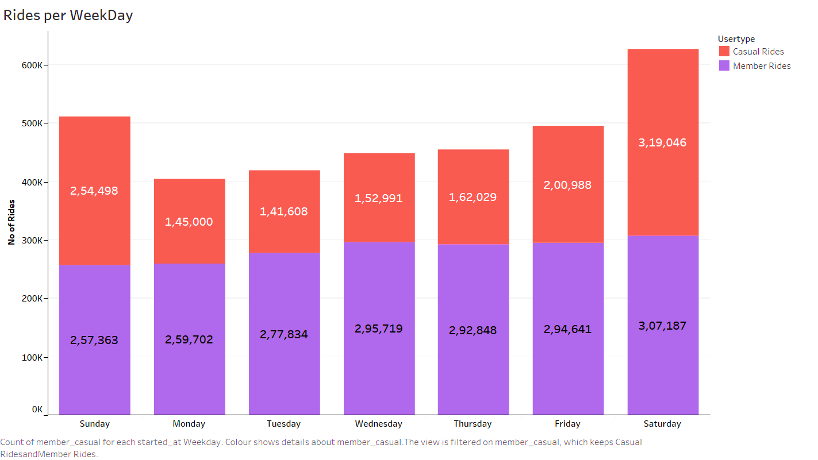
Key Findings: Rides by User Type
There are 1.4 times as many Members Rides compared to Casual Rides.
The number of rides tends to increase on weekends.

Slide 12
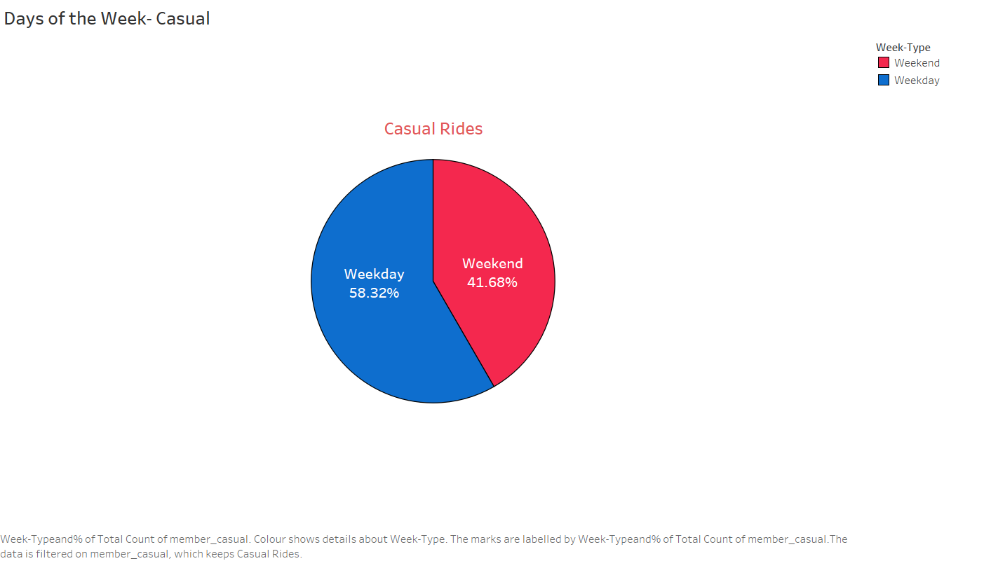
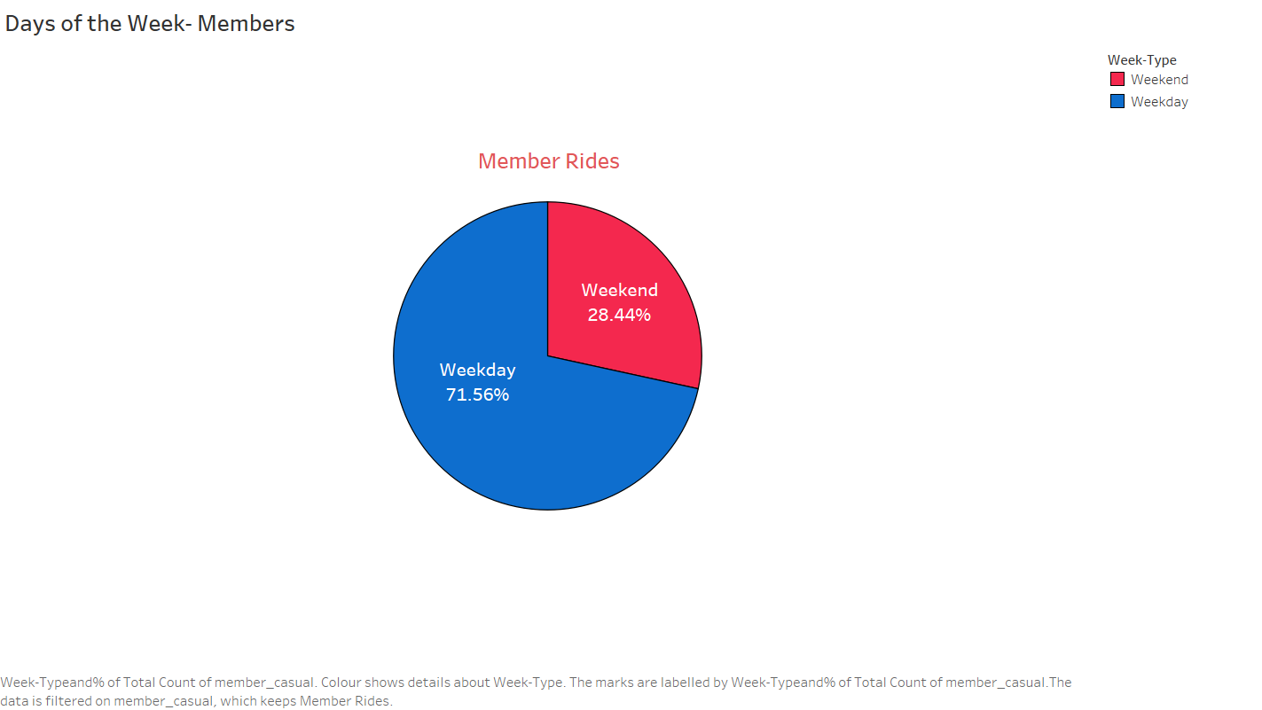
Key Findings: Days of the Week
April 2020- March 2021

Slide 13
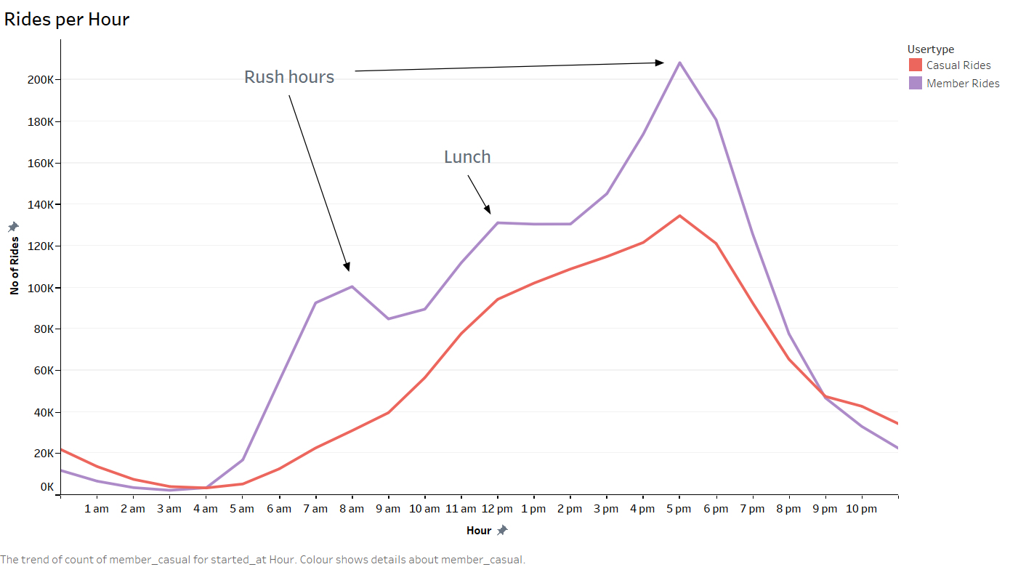
Key Findings: Rides per Hour
There is a notable increase in ride volume during the morning at 8 am and in the evening at 5 pm, which coincides with typical office hours. This implies that individuals utilize the bike service for their daily work commutes, highlighting the popularity of bikes as a preferred mode of transportation during peak commuting times.

Slide 14
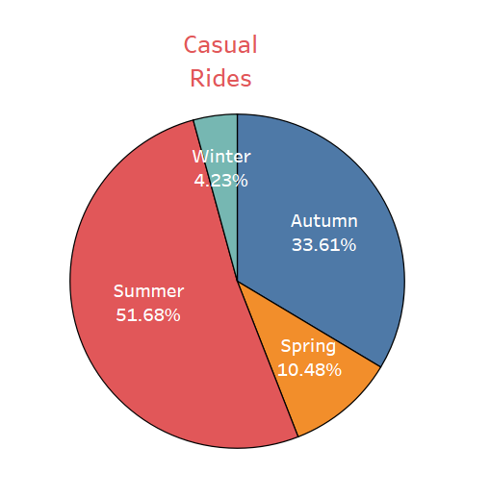
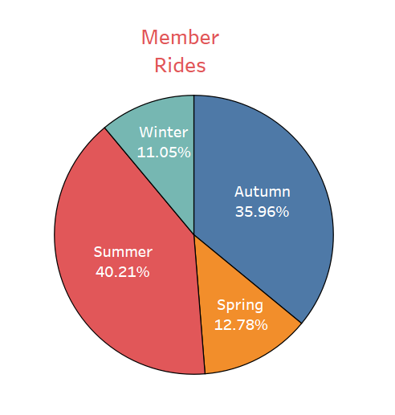
Key Findings: Rides per Season
April 2020- March 2021

Slide 15
Key Findings: Rides per Season
Ratio of Members to Casuals bike rides = 1.44:1
Season | No of Rides | % of Total | Casuals | Members
Spring | 3,97,946 | ~12% | ~36% | ~64%
Summer | 15,09,496 | ~45% | ~52% | ~48%
Fall | 11,76,419 | ~35% | ~39% | ~61%
Winter | 2,77,593 | ~8% | ~21% | ~79%

Slide 16
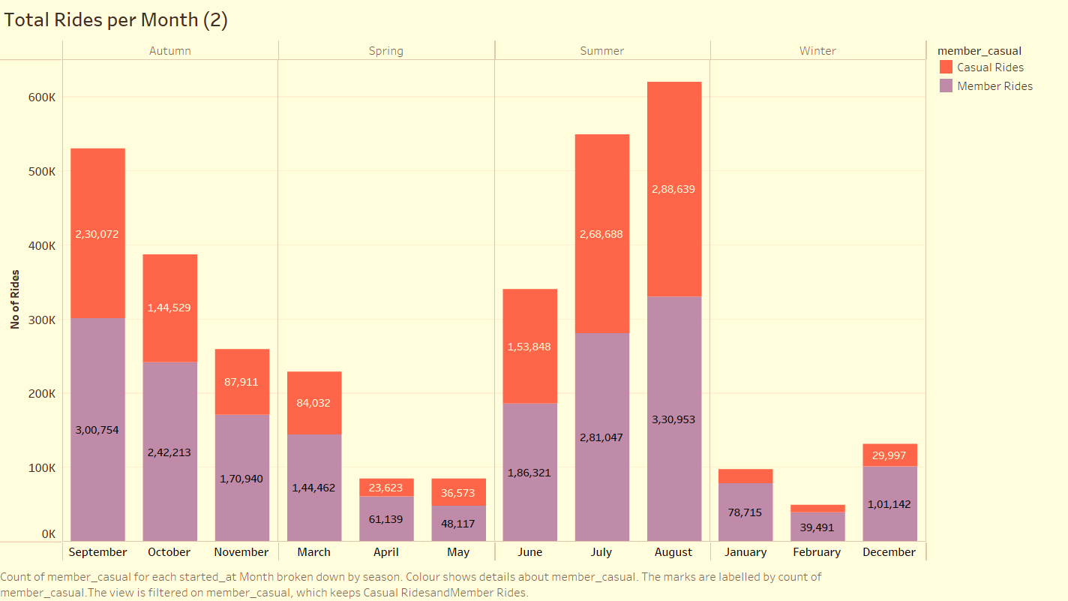
Key Findings: Rides by User Type (Month)
Both casual riders and annual members experience a surge in the number of rides during the month of August, indicating that August is the peak period for bike usage among both groups.
This can be due to favourable weather conditions, summer holidays, or local events.

Slide 17
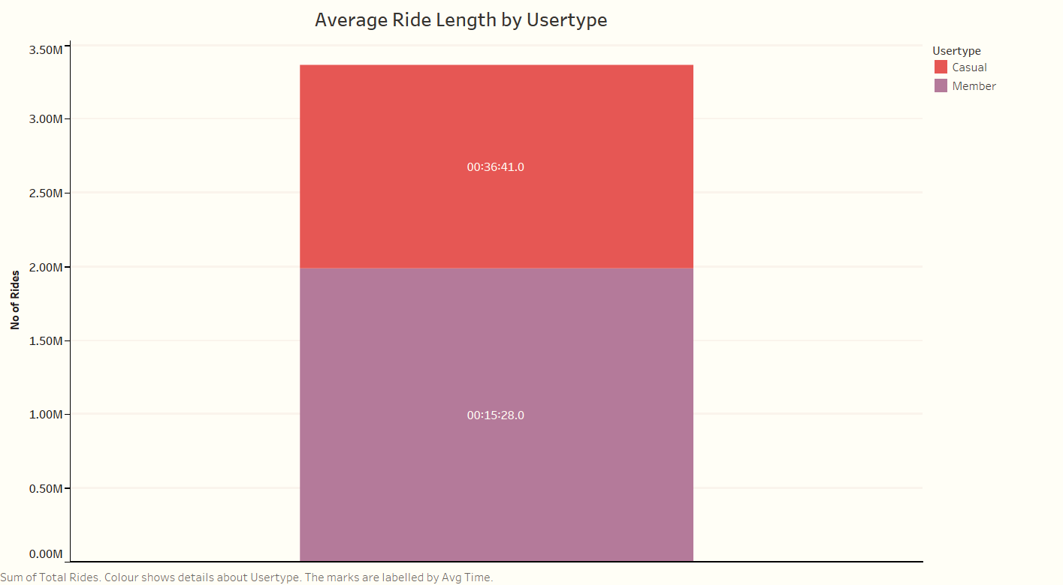
Key Findings: Average Ride Length
The average duration of rides for Annual Members is approximately 15 minutes, whereas for Casual Riders, it is approximately 36 minutes.

Slide 18
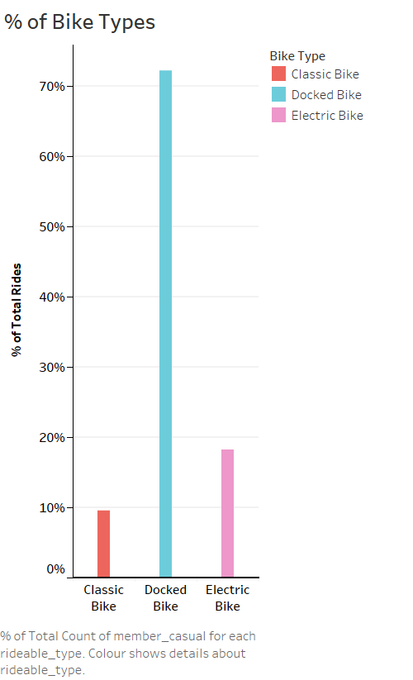
Key Findings: Bike Types used by Riders
The majority of rides, comprising around 72% of the total, are done using Docked bikes. Electric bikes account for approximately 18% of rides, while Classic bikes make up around 10% of rides. This suggests that riders show a greater preference for the convenience and accessibility provided by Docked bikes.

Slide 19
Conclusion
Based on the insights, we can draw the following conclusions:
1. The number of rides taken by Annual Members is 1.4 times higher than the number of rides taken by Casual Riders. This suggests that there is a higher demand for the bike service among Members.
2. Weekends show an increase in the number of rides, indicating that people are more likely to use the bike service for leisure or recreational purposes during their free time.
3. Both Annual Members and Casual Riders experience a surge in the number of rides during the month of August. This indicates that August is the peak period for bike usage among both groups. The reasons for this surge could be favorable weather conditions, summer holidays, or local events that encourage more people to use bikes.
4. The number of rides varies across seasons, with the highest number of rides recorded during the summer season, followed by fall, spring, and winter. This suggests that people tend to use bikes more frequently during warmer seasons.

Slide 20
5. The average ride duration for Annual Members is approximately 15 minutes, while for Casual Riders, it is approximately 36 minutes. This difference in duration could be due to varying trip purposes, distances travelled, or riding preferences between the two groups.
6. There is a significant surge in the number of rides at 8 am and 5 pm, which aligns with typical office timings. This suggests that people use the bike service for their daily commutes, indicating that bikes are a popular mode of transportation during peak commuting hours.
7.In terms of Bike types, the majority of rides (approximately 72%) are taken on Docked bikes, followed by Electric bikes accounting for approximately 18% of rides, and Classic bikes accounting for approximately 10% of rides. This indicates a higher preference for the convenience and availability of Docked bikes among riders.
In conclusion, the provided information highlights the demand patterns, peak periods, and preferences of riders. To capitalize on these findings, strategies can be implemented to cater to the increased demand on weekends, leverage the peak period in August, optimize the bike fleet composition, and provide convenience for office commuters. Additionally, focusing on the popular Docked bikes while maintaining the availability of Electric bikes can further enhance the overall riding experience for users.

Slide 21
Why would casual riders buy Cyclistic Annual Memberships?

Slide 22
Cyclistic Pricing Model
Starting at
$9/per Ride
Starting at
$15/per Day
$99/Year
QuickRide
Day Explorer
Pro Rider Club
Validity | Single Ride | 24 Hour | 12 Months
Unlimited Rides
Priority Access
Advance Reservation
Track Ride Statistics
Enhanced Customer Support
Exclusive Partner Offers

Slide 23
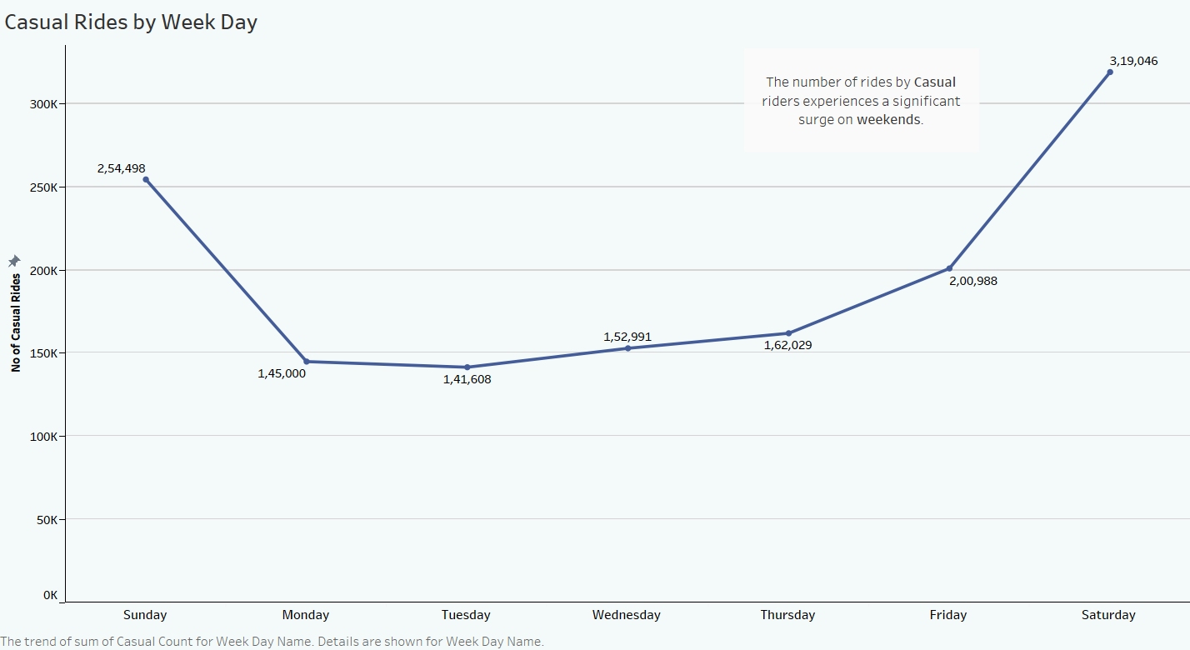
Key Findings: Casual Rides by Week Day
This indicates a substantial rise in ride activity as the week progresses, with weekends being the peak period for Casual riders to use the service.

Slide 24
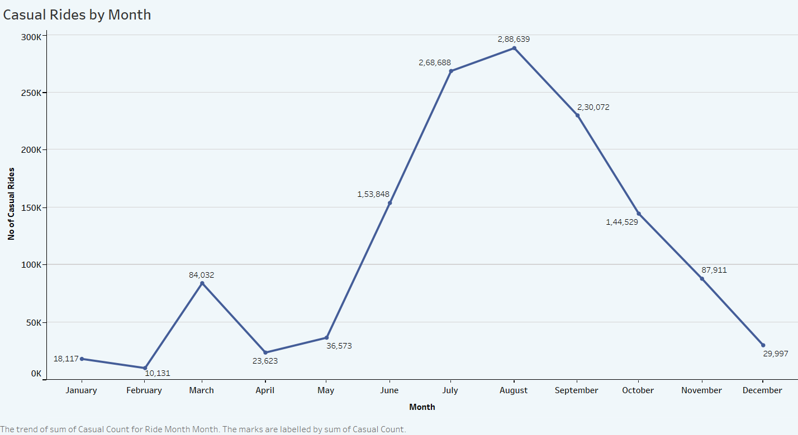
Key Findings: Casual Rides by Month
The increase in the number of casual rides after May and the subsequent decline after August suggests that ridership patterns among casual riders may be influenced by seasonal factors or specific events. However, as the summer season comes to an end, the demand for casual rides diminishes, leading to a decline in ridership.

Slide 25
Casual riders may have various reasons for considering a Cyclistic Annual Membership despite their occasional or sporadic use of the service. Here are some possible reasons why casual riders might choose to purchase an annual membership:
1. Cost Savings: If casual riders anticipate using the bike service frequently throughout the year, an annual membership can offer significant cost savings compared to purchasing single-ride passes or full-day passes for each individual ride.
2. Convenience and Flexibility: An annual membership provides casual riders with the convenience of accessing bikes whenever they need them, without the hassle of purchasing passes for each ride. They can simply pick up a bike and go, making it a seamless and time-saving option.
3. Priority Access and Availability: Annual members often receive priority access to bikes during peak periods, ensuring that bikes are readily available even during high-demand times. This can be especially beneficial for casual riders who want the assurance of bike availability when they need it most.

Slide 26
4. Longer Ride Durations: Annual memberships often come with extended ride durations, allowing casual riders to enjoy longer rides without having to worry about exceeding time limits associated with single-ride passes.
5. Exclusive Membership Benefits: Annual members may have access to additional perks and benefits such as bike maintenance services, discounts on accessories, personalized recommendations, or special offers from partner businesses. These exclusive benefits can enhance the overall experience for casual riders and make the annual membership more enticing.
6. Motivation for Regular Riding: By purchasing an annual membership, casual riders may find themselves more motivated to use the service frequently and make the most of their investment. It can serve as an encouragement to incorporate cycling into their regular routine, leading to potential health and fitness benefits.
It's important for Cyclistic to effectively communicate these advantages to casual riders and showcase the long-term value and convenience of an annual membership. Offering competitive pricing, highlighting the benefits, and addressing any concerns or barriers to adoption can help attract casual riders to consider the option of becoming annual members.

Slide 27
How can Cyclistic use digital media to influence casual riders to become members?

Slide 28
Cyclistic can leverage digital media in various ways to influence casual riders to become members. Here are some strategies:
1. Targeted Online Advertising: Utilize targeted online advertising campaigns to reach casual riders who have already shown an interest in cycling or bike-sharing services. Advertise the benefits and value of annual memberships through platforms such as social media, search engines, and relevant websites.
2. Engaging Social Media Presence: Maintain an active and engaging presence on social media platforms to connect with casual riders. Share compelling content, such as success stories from existing members, special promotions, and exclusive perks available to annual members. Encourage user-generated content and engage with users through comments and messages.
3. Influencer Partnerships: Collaborate with influential bloggers, vloggers, or social media personalities who have a relevant audience or strong following in the cycling or outdoor activities niche. Have them promote the benefits of becoming an annual member through sponsored content, reviews, or exclusive discount codes.

Slide 29
4. Educational Content: Create informative and educational content that addresses the concerns or questions of casual riders. Develop blog articles, videos, or infographics that highlight the advantages of annual memberships, such as convenience, flexibility, and access to a larger network of bike stations.
5. Referral Programs: Implement a referral program that incentivizes existing annual members to refer their friends or colleagues who are casual riders. Offer rewards, such as free ride credits or exclusive benefits, to both the referrer and the new member. Promote the referral program through digital channels and encourage social sharing.
6. Interactive Online Experience: Develop an interactive and user-friendly website or mobile app that showcases the benefits of annual memberships. Provide features such as a cost comparison calculator, interactive maps displaying bike stations and available bikes, and a seamless sign-up process.
7. Customer Reviews and Testimonials: Highlight positive reviews and testimonials from satisfied annual members on the Cyclistic website and social media channels. Encourage existing members to share their experiences and benefits they have gained from their annual memberships.
By utilizing these digital media strategies, Cyclistic can effectively reach and influence casual riders to consider and ultimately convert into annual members.

Slide 30
Recommendations
Free Trial Period
The Free trial period will allow casual riders to experience the benefits of our annual membership program firsthand. It provides an opportunity for them to fully explore the features, convenience, and cost-effectiveness of being a Cyclistic Annual member.
Purpose: Offer a trial period for casual riders to experience the benefits of annual membership.
Benefits: Enhanced value, convenience, and cost savings.
Duration: Set a specific trial period length.
Communication: Implement targeted marketing to promote the trial period.
Data Collection: Measure key metrics for evaluation.
Financial Considerations: Investment required, but potential ROI justifies it.

Slide 31
Flexible Pricing Structure for Weekend or Monthly Subscriptions
The purpose of introducing the new subscription plan is to cater to the demands of customers who prefer shorter-term commitments or occasional bike usage. By offering weekend or monthly subscription options, we can tap into a market segment that seeks flexibility and affordability while still enjoying the benefits of our bike service.
Purpose: Introduce a flexible pricing structure for weekend or monthly subscriptions to attract new customers.
Benefits: Convenient and cost-effective options for weekend or month-long bike usage.
Duration: Offer weekend or monthly subscription plans with customizable start and end dates.
Communication: Clearly communicate the benefits and pricing options through targeted marketing campaigns.
Data Collection: Track customer preferences and usage patterns to optimize pricing and plan offerings.
Financial Considerations: Analyze potential revenue impact and adjust pricing to ensure profitability.

Slide 32
"Summer on Wheels" Bike Subscription Campaign
Summer is the ideal time to launch the campaign due to favorable weather, increased bike usage, and a surge in rides. By capitalizing on this peak season, Cyclistic can attract new customers, drive subscription sign-ups, and establish a strong market presence.
Purpose: Launch a summer campaign to promote bike subscriptions and increase ridership.
Benefits: Enjoy the convenience and freedom of bike usage during the summer season.
Target Audience: Outdoor enthusiasts, tourists, and eco-conscious individuals seeking a convenient mode of transportation.
Messaging: Highlight the cost savings, flexibility, and adventure of summer bike subscriptions.
Channels: Utilize digital ads, outdoor signage, and partnerships with local businesses and event organizers.
Tracking: Monitor campaign performance through key metrics like impressions, click-through rates, and subscription sign-ups.
Budget: Allocate a sufficient budget to reach and engage the target audience effectively.
Outcome: Drive subscription sign-ups, boost revenue, and establish Cyclistic as a top choice for summer bike rentals.

Slide 33
Methodology
For the Cyclistic bike-share case study, the data source used is the historical trip data from April 2020-March 2021.
Organize and format the data, perform calculations, identify trends, and summarize the analysis. Used SQL Server for Analysis.
Draw conclusions from the analysis, apply insights to the business.
ASK
PREPARE
PROCESS
ANALYZE
SHARE
ACT
Identify the business task and consider key stakeholders.
Clean and manipulate the data using appropriate tools, ensuring data integrity and documenting the cleaning process. Used Pandas for Cleaning.
Determine the best way to share your findings, create effective data visualizations, present your findings, and ensure accessibility.

Slide 34
Thanks!
Thank You for Your Attention and Support
We appreciate your time and participation
For any further questions or inquiries, please feel free to reach out to us

